Slide 1
Digital Signal Processing(BEC-42)
Unit-2
Lecture-9
(Frequency Transformation)
Date:08/10/2020

Slide 2
Frequency Transformation
Types of frequency selective filters:
Low-pass
High-pass
Band-pass
Stop-band
System Function of analog LPF
Frequency Transformation
Transformation for digital filter

Slide 3


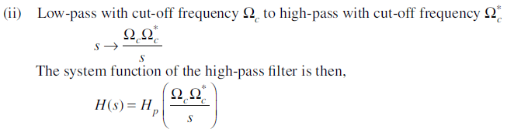

Slide 4
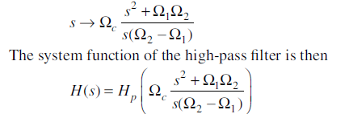
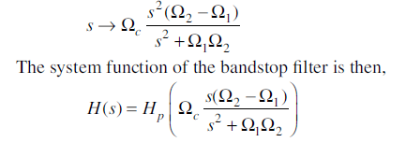

Slide 5
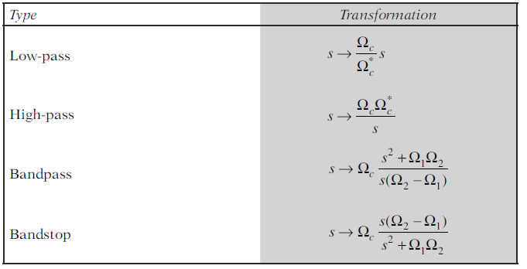

Slide 6
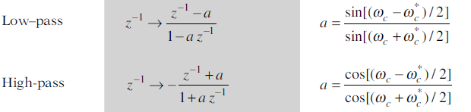
Transformation is obtained by replacing by a function of ,i.e.

Slide 7
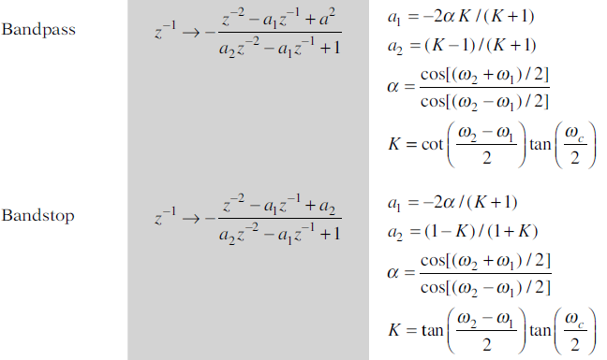

Slide 8

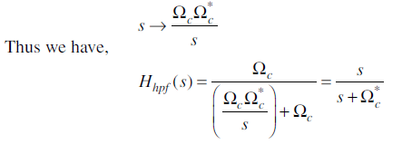
Problem: Transform the prototype LPF with system function
into a high-pass filter with cut-off frequency ..
Solution:

Slide 9
Problem: Design an BPF to satisfy the following specifications:
3 dB upper and lower cut-off frequencies are 100 Hz and 3.8 kHz.
Stop-band attenuation of 20 dB at 20 Hz and 8 kHz.
No ripple with both pass-band and stop-band.

Slide 10
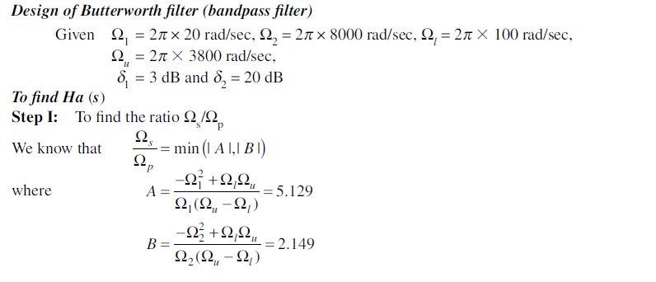
Solution:

Slide 11
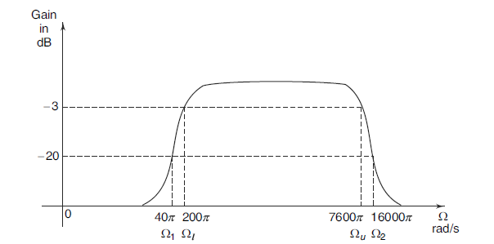


Slide 12
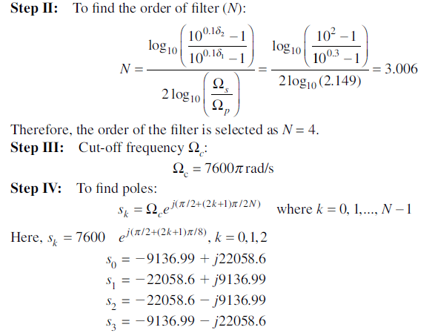

Slide 13
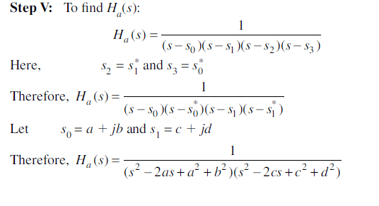
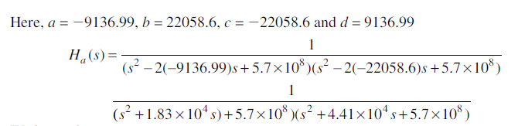

Slide 14
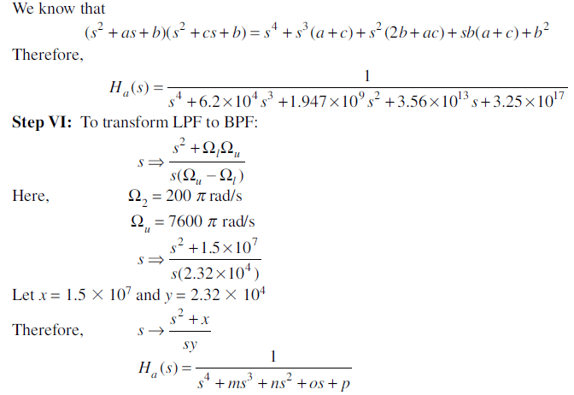

Slide 15
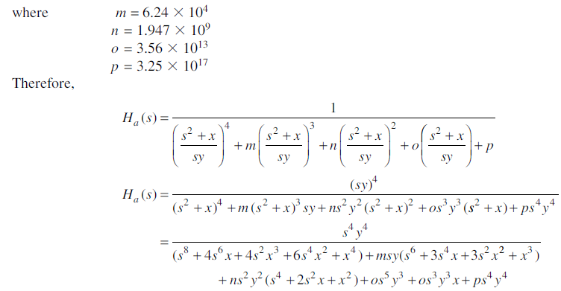


Slide 16
